Slide 1
Smart Mirror
Midterm Progress
Group 36: Kingsley Chu, Adams Liu, Ian Chang
Date: dEC/05/2019

Slide 2



Divided the roles into 3 parts
Hardware/Frame Development
[Ian Chang]
Amazon Voice Development [Adams Liu]
Fullstack + GUI Development
[Kingsley Chu]

Slide 3
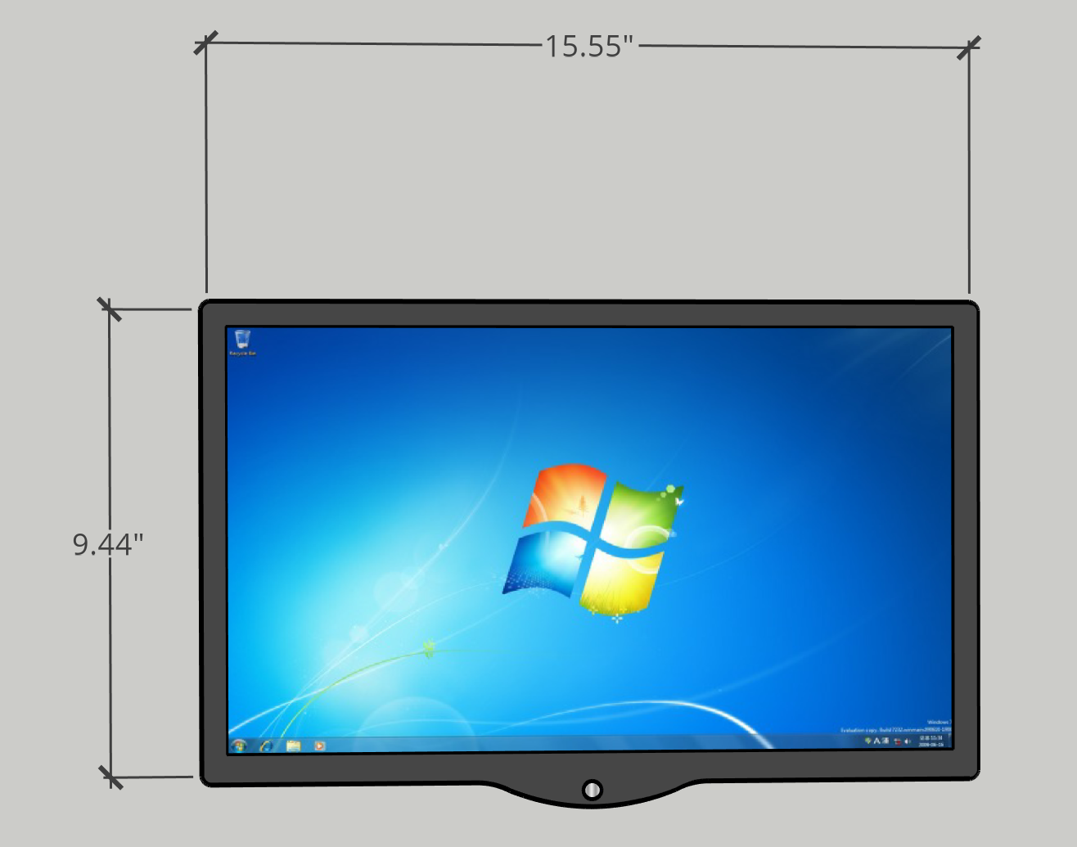
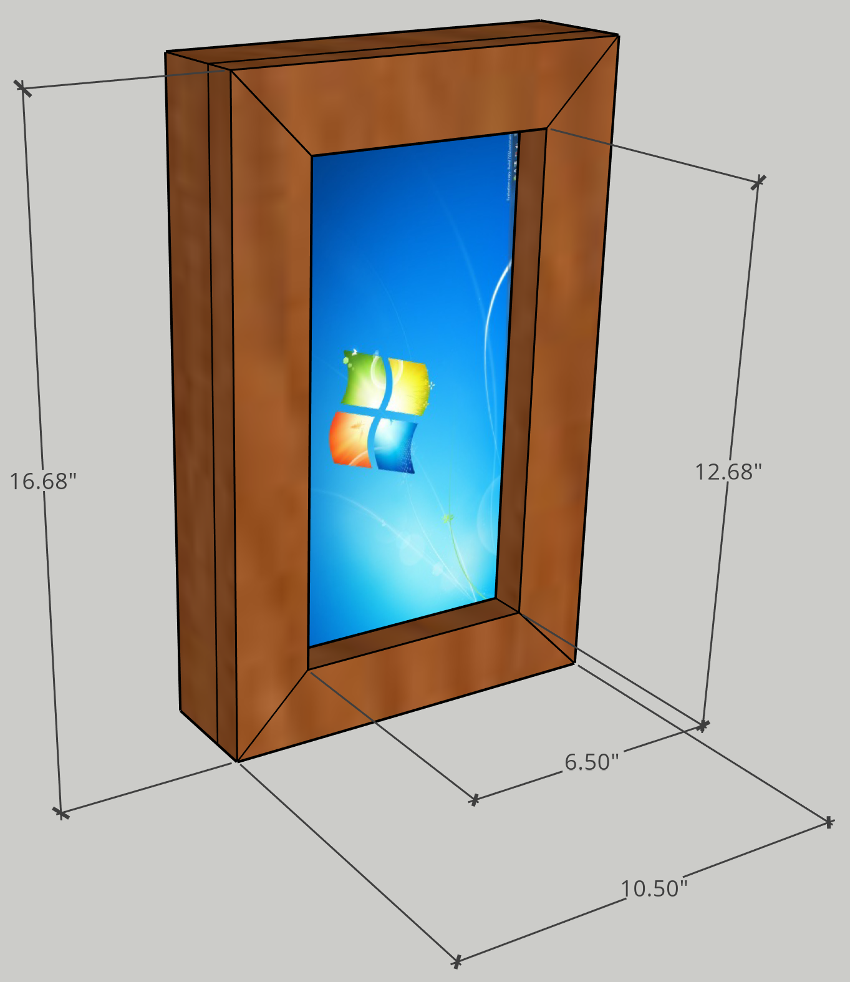
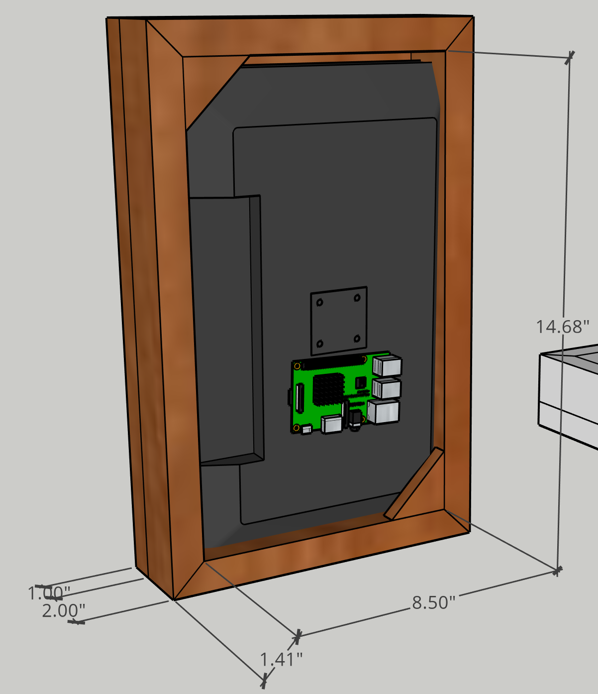
Hardware & Materials

Slide 4
List of Materials
Item | Price
1x3x8 Pine Lumber | $8.21
1x2x8 Pine Lumber | $5.80
21’ Monitor (19.6 x 8.3 x 15.11) | $132.82
Window Film (36” by 15ft) | $50.69
PIR Sensor | $3.44
RGB Programmable LEDs | $13.99
Plexiglass (12x24”) | $27.49
Subtotal | $242.44
HST | $35.61
Total | $278.05

Slide 5
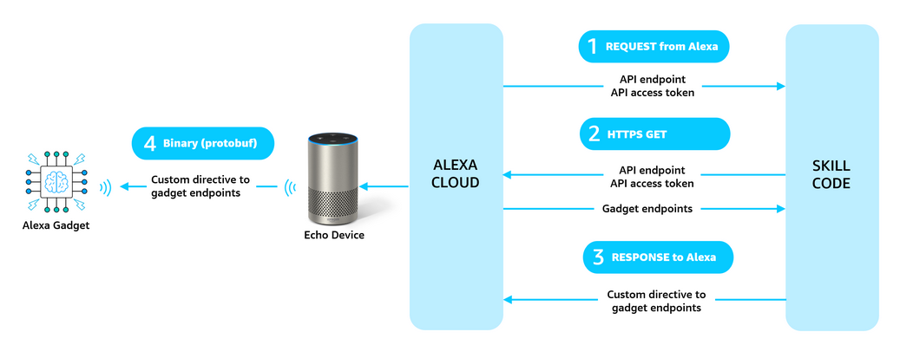
Alexa voice integration

Slide 6
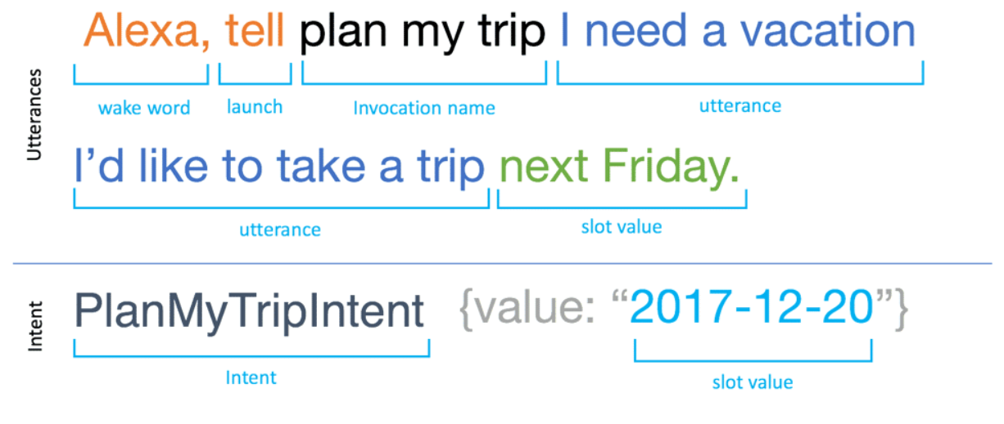
Voice User Interface

Slide 7
Utterance and Intent (Schedule)
Utterance:
"what's my schedule"?
"what does my schedule look like for today?"
"what's today's agenda?"
"what's today's to-do list?"
"what am I doing today?"
Intent 1: ReadScheduleIntent {value: 2019-12-05}
Call onto calendar API and return and responds by listing out schedule items for listed date
Intent 2: OpenCalendarIntent {value: 2019-12-05}
Communicates with Raspberry Pi to launch Calendar display for listed date

Slide 8

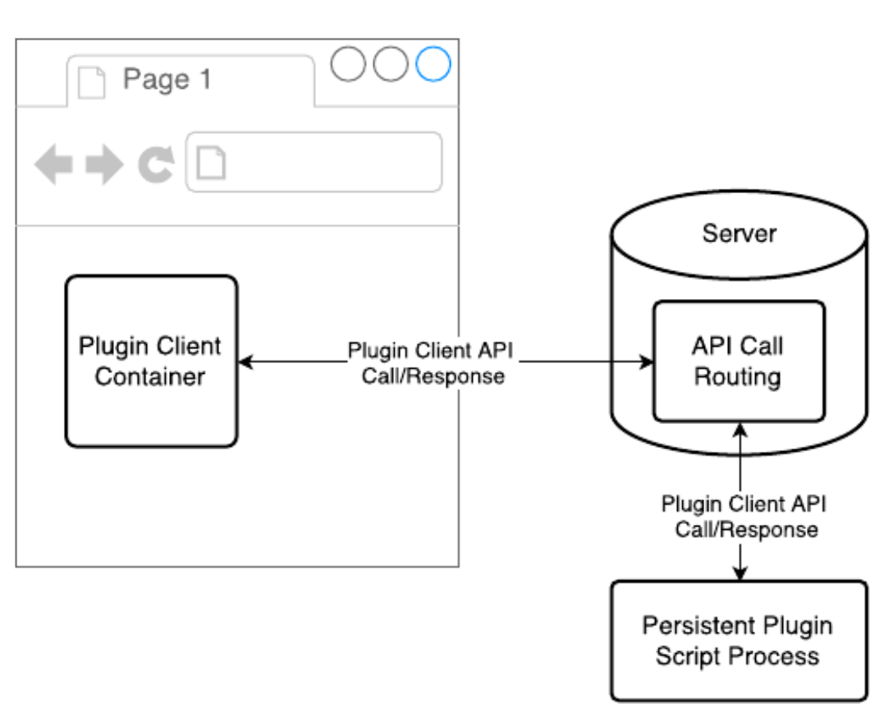

Software & UI

Slide 9
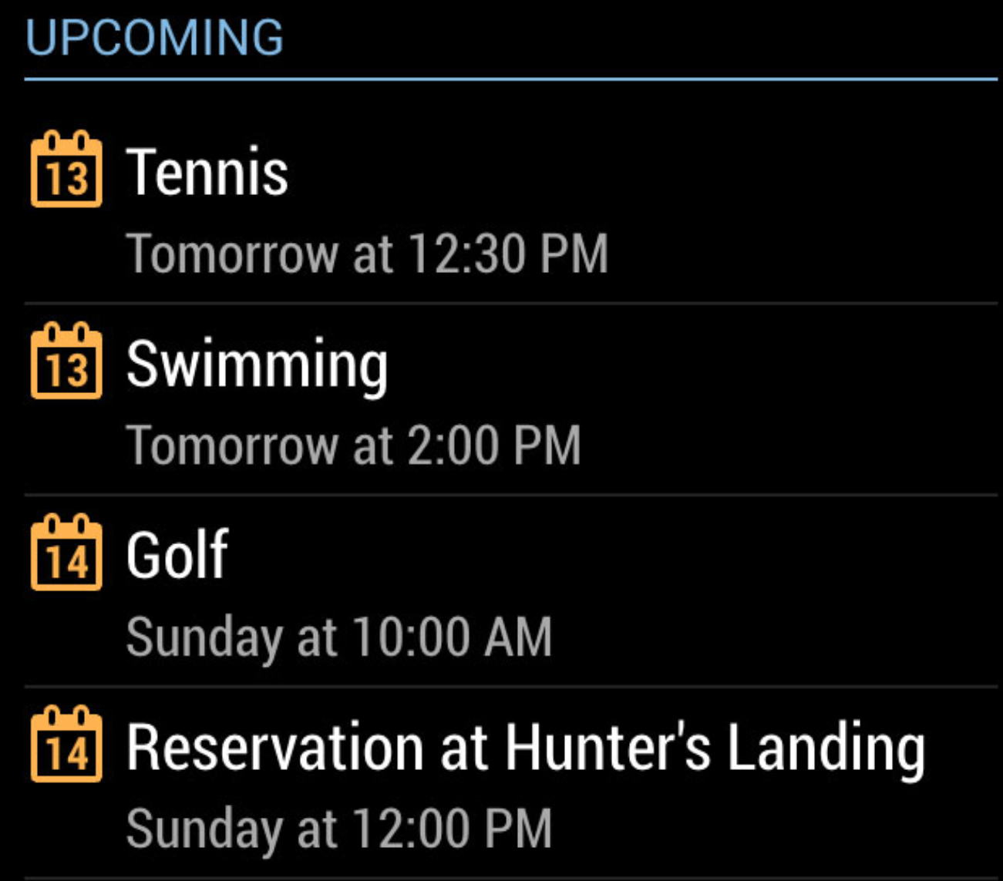
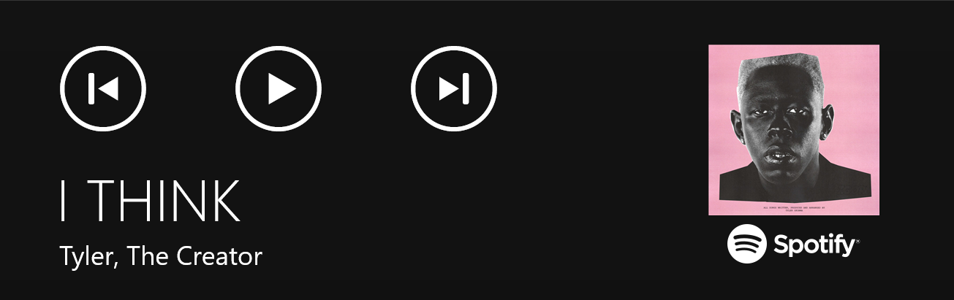
9:59
23°
a.m.
Clear Sky
Wednesday, March 16
Toronto
Hello,
John!

Slide 10
Next Steps
Build the mirror
Integration development between Alexa, Raspberry Pi, and Mirror
Integration testing with between the ecosystem

